Slide 1
PACT
CONTRACT TESTING

Slide 2
Biggest problem with current E2E and integration testing:
Time consuming
Expensive
Don’t worry PACT to the rescue, but let's discuss about some basics first!

Slide 3
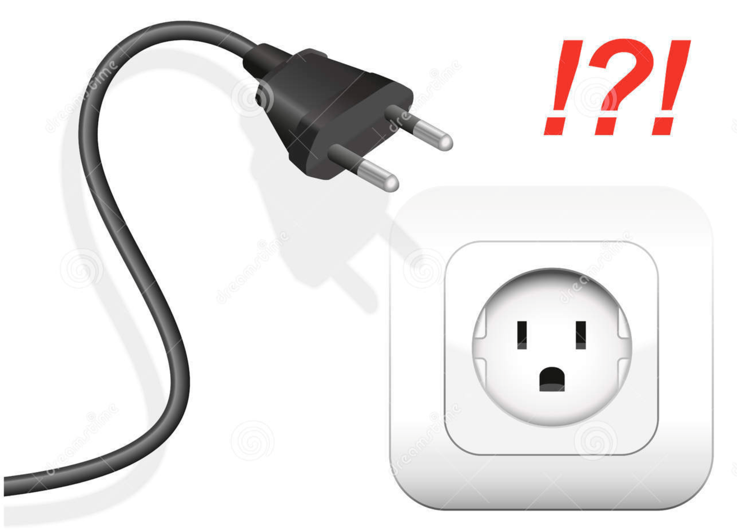
What is Contract and why we need it?

Slide 4
What is contract testing?
Contract testing is a technique for testing an integration point by checking each application in isolation to ensure the messages it sends or receives conform to a shared understanding that is documented in a "contract"
What are the types of contract testing?
Consumer driven contract testing
Producer driven contract testing
PACT – Consumer driven contract testing

Slide 5
What is Pact good for?
Pact is most valuable for designing and testing integrations where:
You (or your team/organisation/partner organisation) control the development of both the consumer and the provider.
The consumer and provider are both under active development.
The requirements of the consumer(s) are going to be used to drive the features of the provider.
There is a small enough number of consumers for a given provider that the provider team can manage an individual relationship with each consumer team.

Slide 6
Primary advantages of PACT are:
You can continuously evolve your codebases knowing that Pact will guarantee contracts are met.
You can find out before you deploy whether or not your applications will work together - there is no need to wait for slow e2e tests.
Pact is fantastic tool for developing and testing intra-organisation microservices.

Slide 7
What is PACT not good for?
Testing APIs where the team maintaining the other side of the integration will not also being using Pact.
Testing APIs where the consumers cannot be individually identified (eg. public APIs).
Testing new or existing providers where the functionality is not being driven or altered by the needs of particular consumers (eg. a public API or an OAuth provider where the API is completely stable)
Performance and load testing.
Functional testing of the provider - that is what the provider's own tests should do. Pact is about checking the contents and format of requests and responses.
Testing "pass through" APIs, where the provider merely passes on the request contents to a downstream service without validating them.
Use as a general purpose mocking or stubbing tool for browser driven tests.

Slide 8
Actors in PACT
Consumer: An application that makes use of the functionality or data from another application to do its job.
Provider: An application (often called a service) that provides functionality or data for other applications to use, often via an API.
Pact: A contract between a consumer and provider is called a pact. Each pact is a collection of interactions

Slide 9
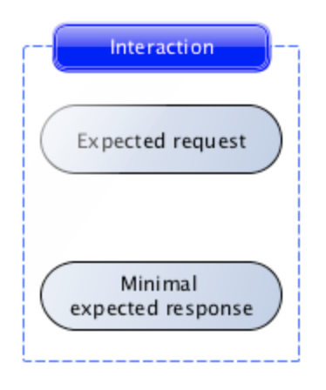
How PACT works
The first step in writing a pact test is to describe an interaction.

Slide 10
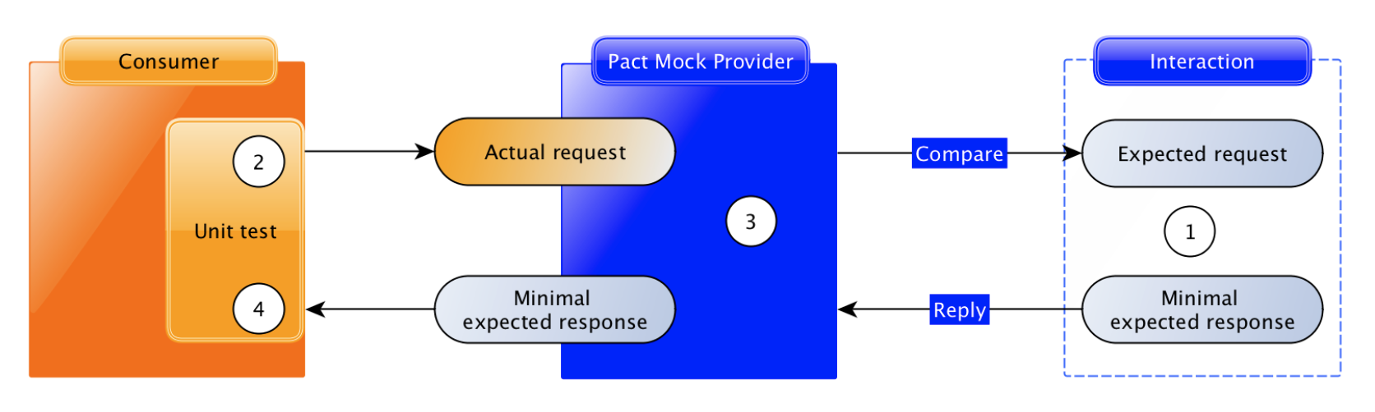
2. Consumer testing
Each interaction is tested using the Pact framework, driven by the unit test framework inside the consumer codebase:

Slide 11
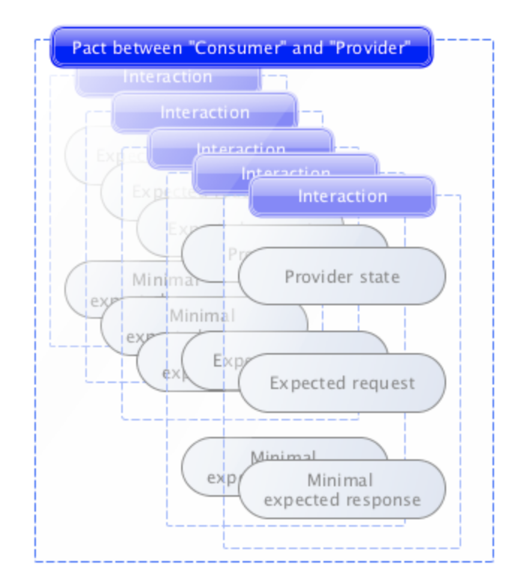
3. PACT file
Once all of the interactions have been tested on the consumer side, the Pact framework generates a pact file, which describes each interaction

Slide 12
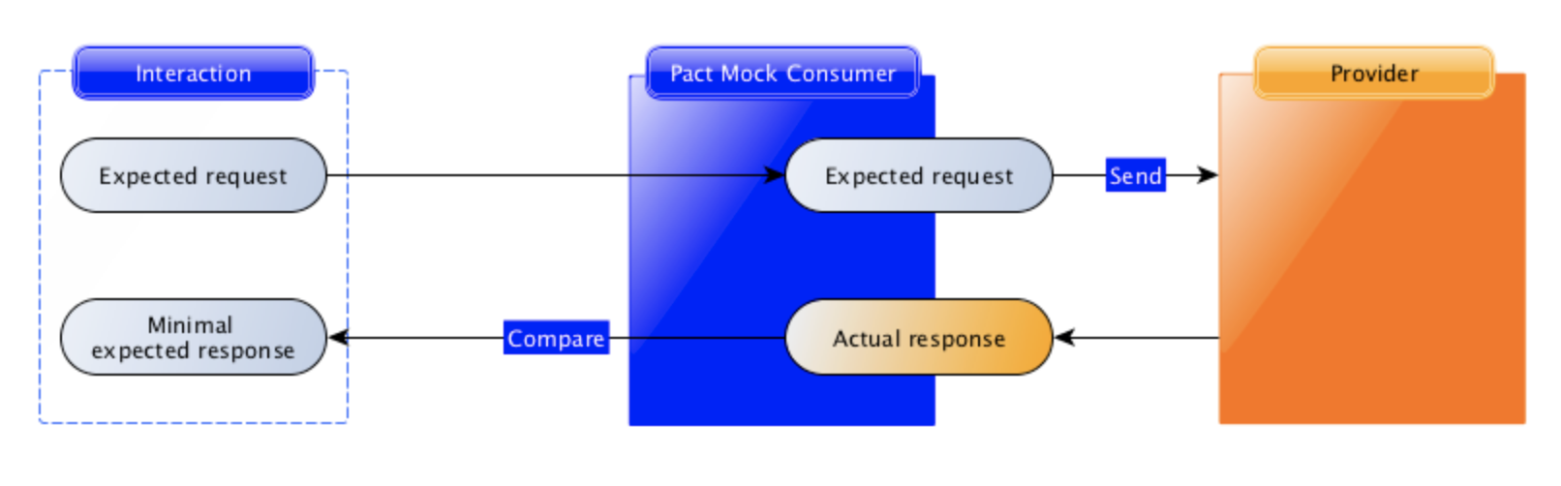
4. Provider verification
In provider verification, each request is sent to the provider, and the actual response it generates is compared with the minimal expected response described in the consumer test.

Slide 13
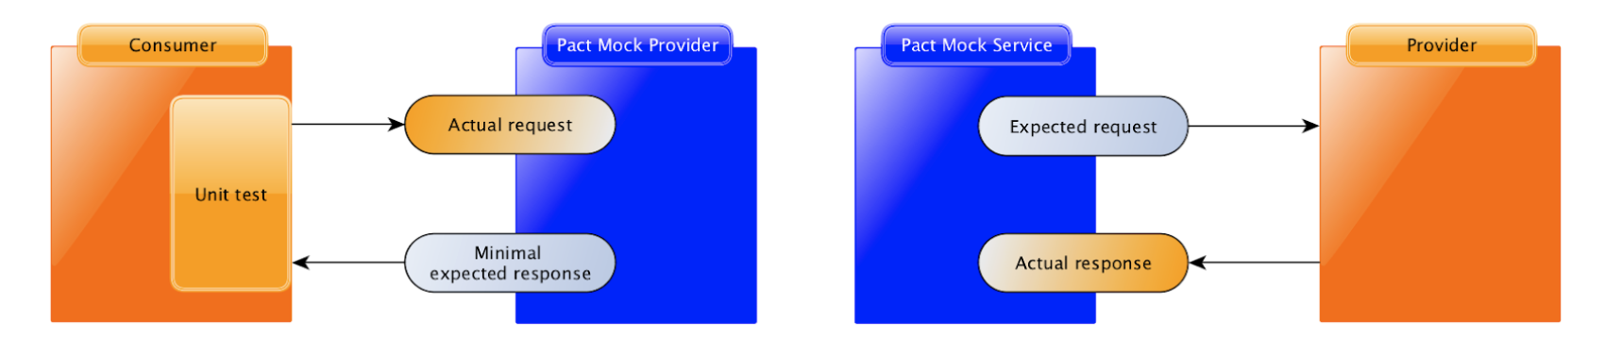
5. The full picture

Slide 14
PACT vs others
Features/Frameworks | Spring cloud Contract | PACT | Accurest | VCR | Webmock | Pacto
Language neutral | No | Yes | No | No | - | -
Pact file generation | Outside the code | As part of test code |  |  |  | As part of test code
Broker | Can be integrated with pact broker | Pact broker | Predecessor of Spring cloud contract. Not in active development. | No clear documentation available | No clear documentation available | Pacto broker
Active development | Yes | Yes | No | Yes | Yes | No

Slide 15
Reference: https://docs.pact.io/

